Slide 1
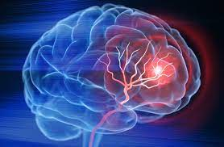
Project 4 Stroke Prediction
Rebecca Butcher

Slide 2
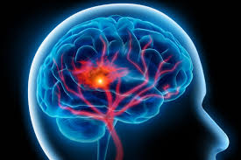
Contents
What is a stroke
Overview of project
Data techniques used
Project implementation
Project Outcome
Visualisation

Slide 3
Stroke

Slide 4
Project objective
To create a machine learning to produce an accurate stroke predictive model

Slide 5
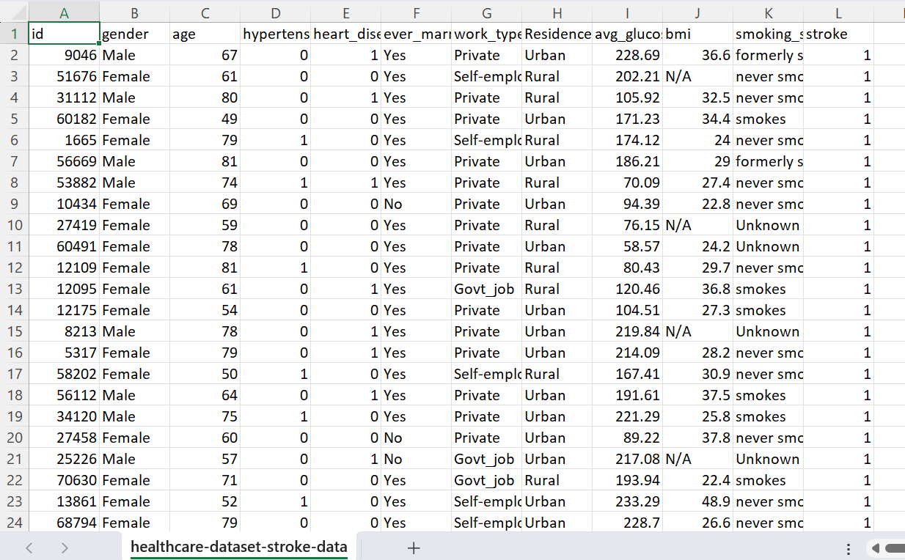
Data
Used a dataset from kaggle
0 4235
1 165

Slide 6
Data machine learning
Reasons for Overfitting:
High variance and low bias.
The model is too complex.
The size of the training data.

Slide 7
Stroke model prediction accuracy
 | Model |  | F1 | Recall | Precision | Accuracy
1 | SMOTE | 0 – no stroke | 0.98 | 1.00 | 0.97 | 98.4
 |  | 1 - stroke | 0.98 | 0.97 | 1.00
2 | Binning + random forest | 0 – no stroke | 1 | 0.99 | 1 | 99.5
 |  | 1 – stroke | 1 | 1 | 0.99
3 | Random Forest | 0- no stroke | 1.00 | 0.99 | 1.00 | 99.6
 |  | 1 – stroke | 1.00 | 1.00 | 0.99

